Slide 1
Section 3.4 Sine Law and Cosine Law
© Copyright all rights reserved to Homework depot: www.BCMath.ca

Slide 2
I) Sine Law
The Sine Law is for solving triangles that are not RT
Name each side with the opposite angle
There are 3 separate equations
The Sine Law can only be used when you are given one of the angles with its opposite side
© Copyright all rights reserved to Homework depot: www.BCMath.ca

Slide 3
Ex: Find the value of “x”
Indicate the sides and angles
Formula
Cross Multiply and Solve for “X”
© Copyright all rights reserved to Homework depot: www.BCMath.ca

Slide 4
II) Finding Missing Angles
To find the angle, you need to use inverse sine
If the angle is obtuse, you need to find the angle in Quadrant #2
Ex: Find the value of “θ” to the nearest degree
Indicate the sides and angles
Formula
© Copyright all rights reserved to Homework depot: www.BCMath.ca

Slide 5
Practice: Find θ to the nearest degree
Formula
Formula
Angle “B” is an OBTUSE angle,
So it must be in Quadrant #2!!
Angle “B” is an OBTUSE angle,
So it must be in Quadrant #2!!
© Copyright all rights reserved to Homework depot: www.BCMath.ca

Slide 6
Ex: The angle of elevation to the top of the tower is 43°. If you travels 100m closer, the angle is 75°. How tall is the tower? Assume the person is about 1.5m tall.
Make a Triangle and Gather Info
Find the Hypotenuse of the triangle
Use the Hypotenuse to find the opposite side
Height of the Tower
© Copyright all rights reserved to Homework depot: www.BCMath.ca

Slide 7
Practice: A ship leaves Batumi on a bearing 300 and sails 860km. They then change direction on a bearing of 222 and sail for 580km and reached Istanbul. How far is Batumi from Istanbul?
Turkey
© Copyright all rights reserved to Homework depot: www.BCMath.ca

Slide 8
III) What is the Cosine Law
The Cosine Law is for solving triangles that are NOT R.T.
You could only use the Cosine Law when you have:
2 sides and the angle in between
All 3 sides and need to find the angles
Finding side “a” or angle A
Finding side “b” or angle B
Finding side “c” or angle C
© Copyright all rights reserved to Homework depot: www.BCMath.ca

Slide 9
EX: FIND THE VALUE OF THE MISSING SIDE “X”
Indicate which side you want to find
Indicate which side you want to find
Plug the values into your formula
Plug the values into your formula
© Copyright all rights reserved to Homework depot: www.BCMath.ca

Slide 10
IV) FINDING ANGLES WITH THE COSINE LAW
When finding angles, isolate the cosine function first
Then use inverse cosine to find the angle
The side opposite of the angle must be on the left of the equation
Indicate which side you want to find
Plug the values into your formula
© Copyright all rights reserved to Homework depot: www.BCMath.ca

Slide 11
Practice: Find the missing angle
Indicate which side you want to find
Plug the values into your formula
© Copyright all rights reserved to Homework depot: www.BCMath.ca

Slide 12
Practice: FIND THE AREA OF THE TRIANGLE
Find one of the angles
Use the angle to find the height of the triangle
© Copyright all rights reserved to Homework depot: www.BCMath.ca

Slide 13
Proof For the Sine Law
If we use another altitude for angle A, we can solve for the other part of the sine law
© Copyright all rights reserved to Homework depot: www.BCMath.ca

Slide 14
Proof For the Cosine Law
© Copyright all rights reserved to Homework depot: www.BCMath.ca

Slide 15
Ex: The angle of elevation to the top of the tower is 43°. If you travels 100m closer, the angle is 75°. How tall is the tower? Assume the person is about 1.5m tall.
Make a Triangle and Gather Info
Find the Hypotenuse of the triangle
Use the Hypotenuse to find the opposite side
Height of the Tower
© Copyright all rights reserved to Homework depot: www.BCMath.ca

Slide 16
Challenge: CNML 1980 Find the ordered pair of real numbers (x,y) for which in triangle ABC, sin A : sin B : sin C = 4 : 5 : 6, while the ratio of cos A: cos B : cos C = x : y : 2
Answer:

Slide 17
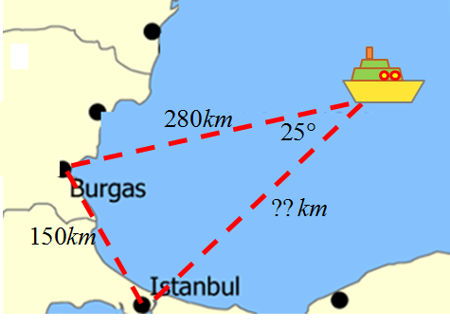

Slide 18
